Slide 1
Are Individual Health Insurance Markets Competitive?
Options Faced by Individuals
Laura Gascue
July 2020

Slide 2
How many health plans are offered through the ACA Individual Markets?
We could go over the long academic discussion on how to measure the level of competition in a market, and discuss for example the HHI. We won’t be doing this.
At the end of the day, the key questions are:
From the consumer point of view: what health insurance options do I have?
From the firm: can the market support one more product?

Slide 3
The Data
(1) 2018 QHP landscape data downloaded from https://www.healthcare.gov/health-plan-information-2018/
(2) Area resource health file downloaded from https://data.hrsa.gov/data/download - Area Health Resources Files (AHRF) 2018-2019. US Department of Health and Human Services, Health Resources and Services Administration, Bureau of Health Workforce, Rockville, MD.
(3) File All_States_Governors_Party.csv identifying state's governor politic party affiliation at the beginning of 2018 for all fifty states, manually constructed through web searches.

Slide 4
Health Insurance Plans Offered
Between 2 and 119 number of plans offered across all counties in the federally regulated market exchanges
Average number of plans: 14
Median number of plans
Number of issuers ranges from 1 to 7, with 75% of counties having one or two participants

Slide 5
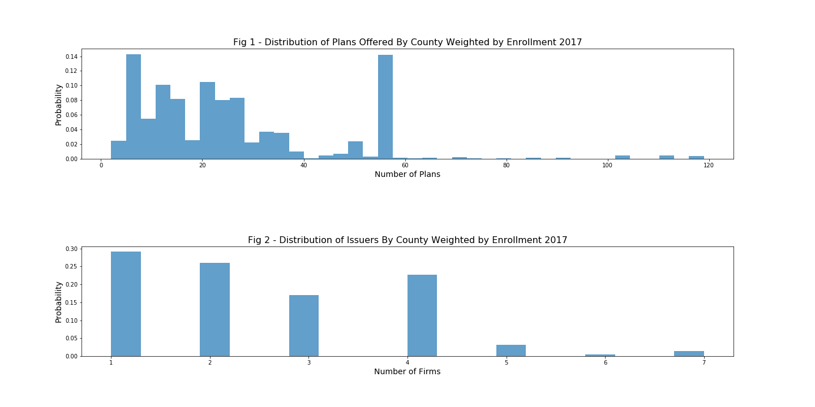

Slide 6
Number of Plans By State
Number of plans offered varies widely by State
Median number of plans by state ranges from 4 to 36
Florida and Wisconsin present the larger median number on options

Slide 7
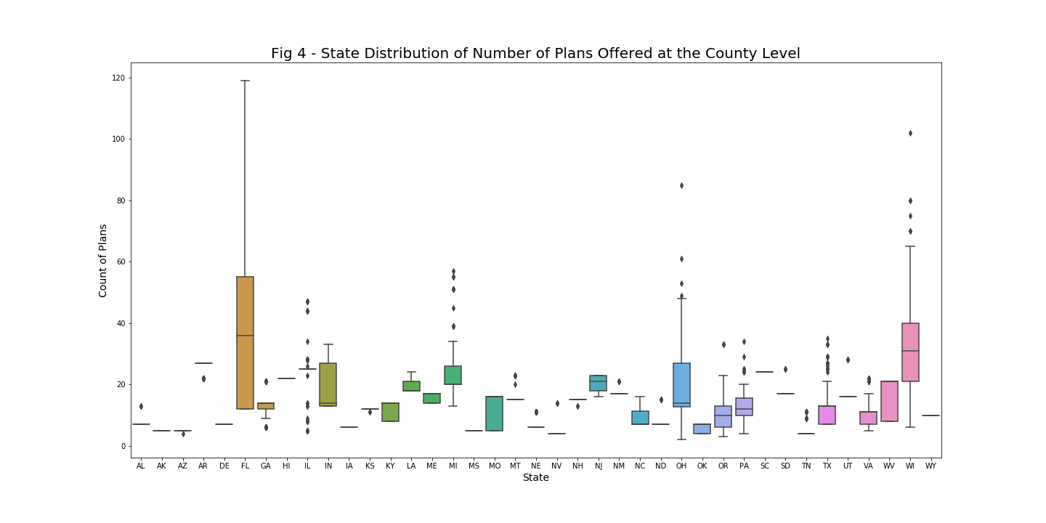

Slide 8
Governor’s Political Affiliation
The majority of States participate in the federally facilitated marketplace
Republican states have a slightly higher average number of plans than democrat states (14.9 vs 13.2)
Republican states opt-out of the state run market place in a larger proportion than democrat states
Republican governor states tend to have fewer issuers
87% of republican counties have just 1 or 2 issuers
64.5% of democratic counties have just 1 or 2 issuers

Slide 9
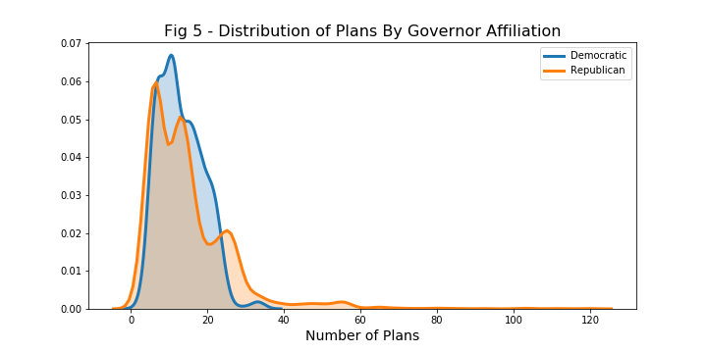

Slide 10
Bootstrap Test of Difference in Means
H0: u_{D} = u_{R}
Variance of both distributions may be different
We shift both distributions so their sample means are the same and draw samples with replacement of the same size of the original data
We replicate the procedure 10,000 to draw the distribution of the mean difference under the null hypothesis
The difference in expected number of plans between Democratic and Republican Governors is significantly different, but small in size

Slide 11
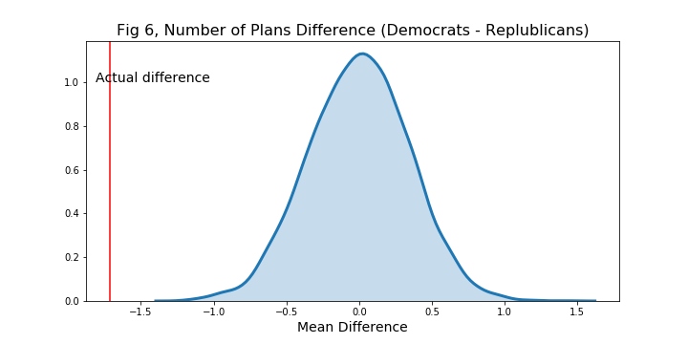

Slide 12
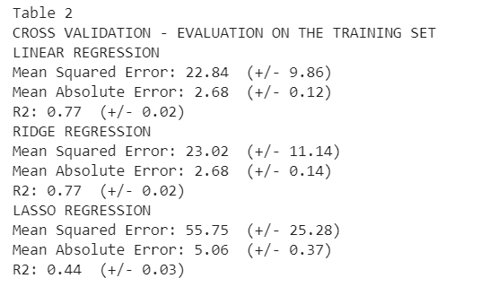
Predicting Number of Plans - Linear Regression

Slide 13
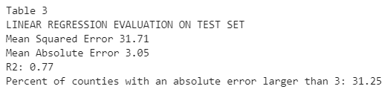
Predicting Number of Plans - Linear Regression
OLS, Ridge and Lasso regression evaluated using MSE, MAE and R2
Use Cross validation on training set
OLS and Ridge regression scores within 95% CI
OLS fit on test set

Slide 14
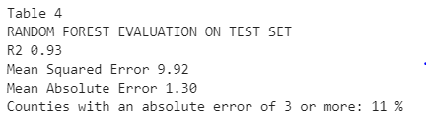
Random Forest
Add flexibility allowing for non-linear fit
We use MSE to evaluate the fit and compare with linear regression

Slide 15
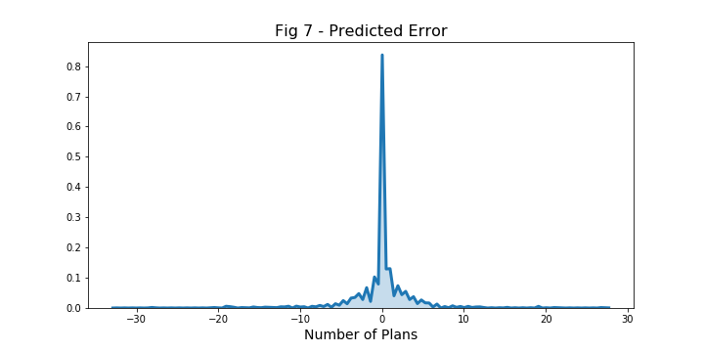

Slide 16
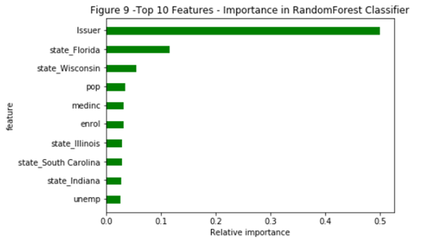

Slide 17
Conclusion
There is low competition in the Health Insurance Individual Market
Number of plans offered at the county level has high variation rates
Number of issuers in each market is very low
There is a larger number of democratic states opting out of the federal Exchange than republican states
The average number of plans offered by republican states is slightly higher than the average on democratic states, but statistically significant
Number of plans offered in a county can be predicted using market characteristics.

